Slide 1
Journey Scrapbook
Akshat Gupta
Batch-3

Slide 2
Custom Training Week - 6
03-Oct-2023 to 06-Oct-2023

Slide 3
Day 1
Machine Learning
Teachable Machine
Case Study Discussions
Overview of Azure ML Studio
Types of Machine Learning Algorithms –
Supervised
Unsupervised
Reinforcement
Semi-Supervised

Slide 4
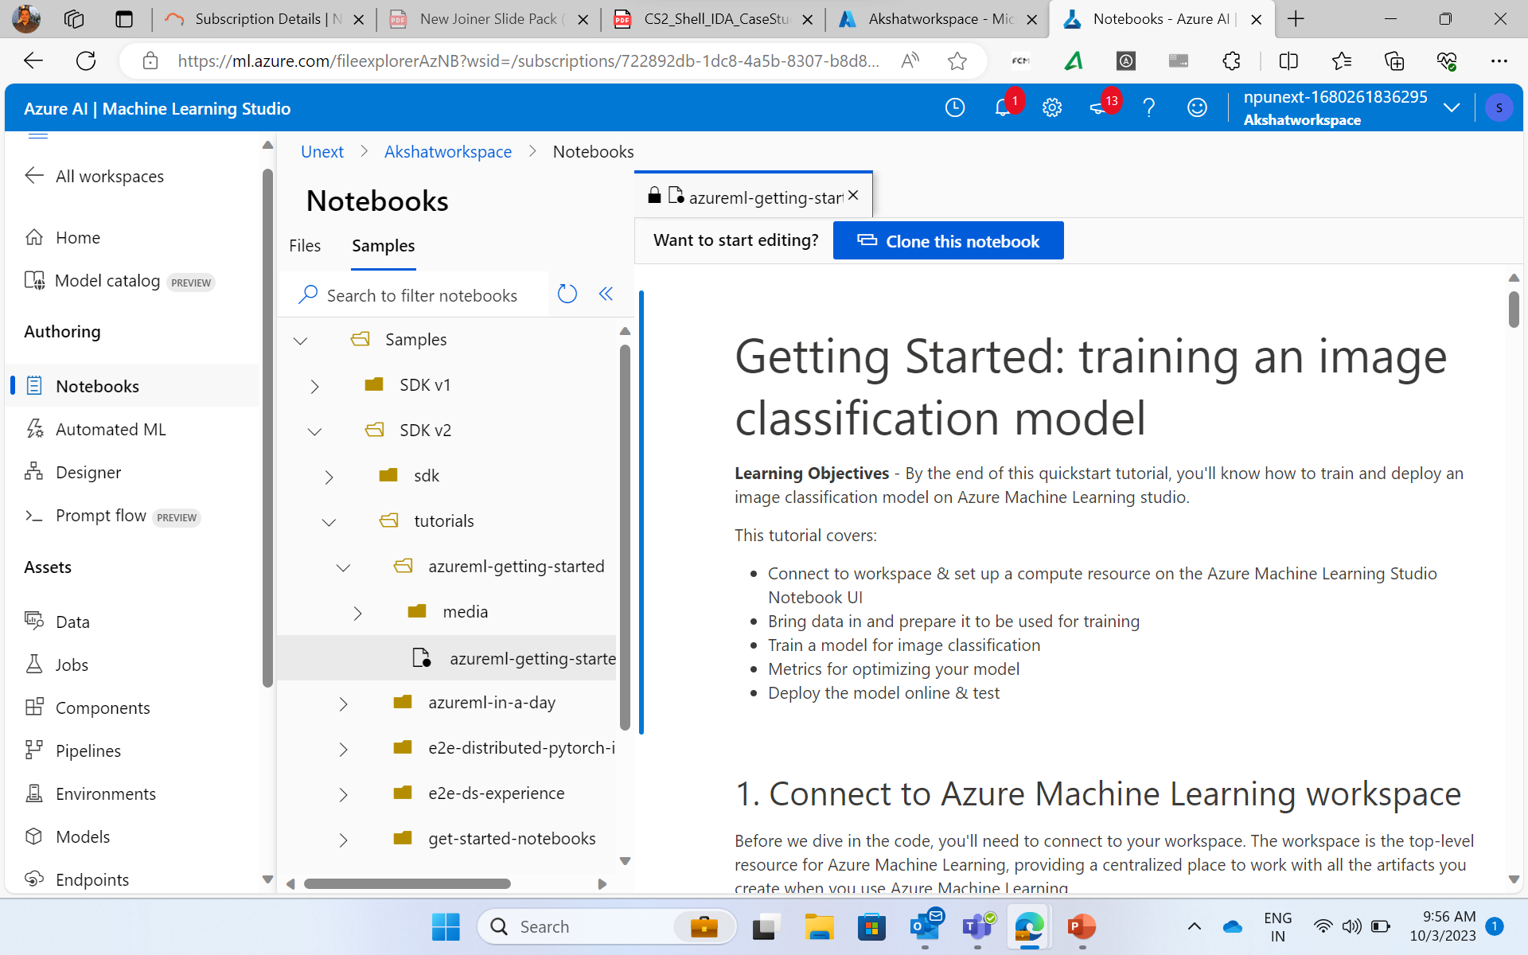

Slide 5
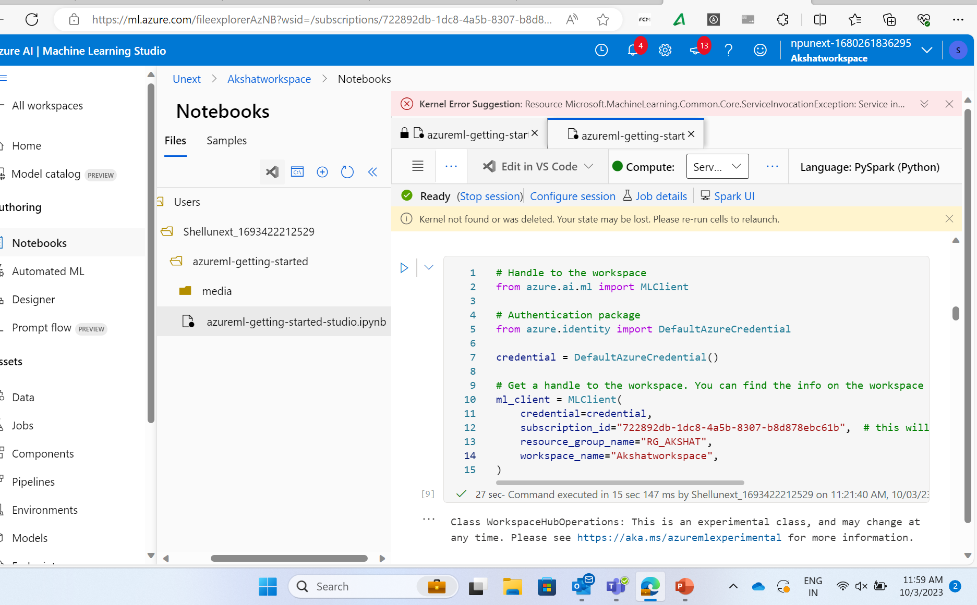

Slide 6
Day 2
Machine Learning Contd.
Machine Learning Studio
Notebooks, Designer, Pipelines
Automated ML

Slide 7
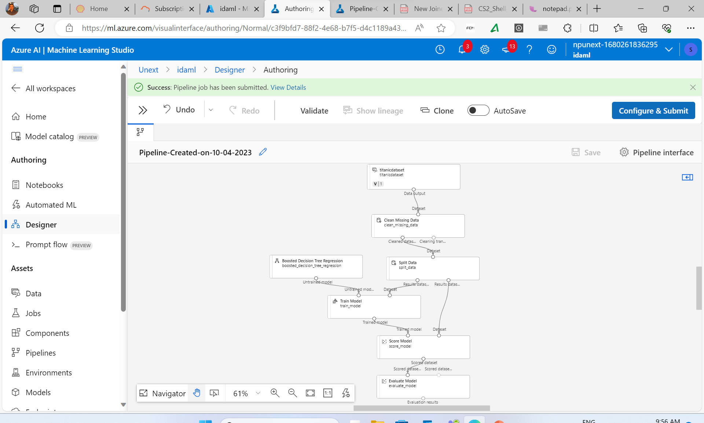

Slide 8
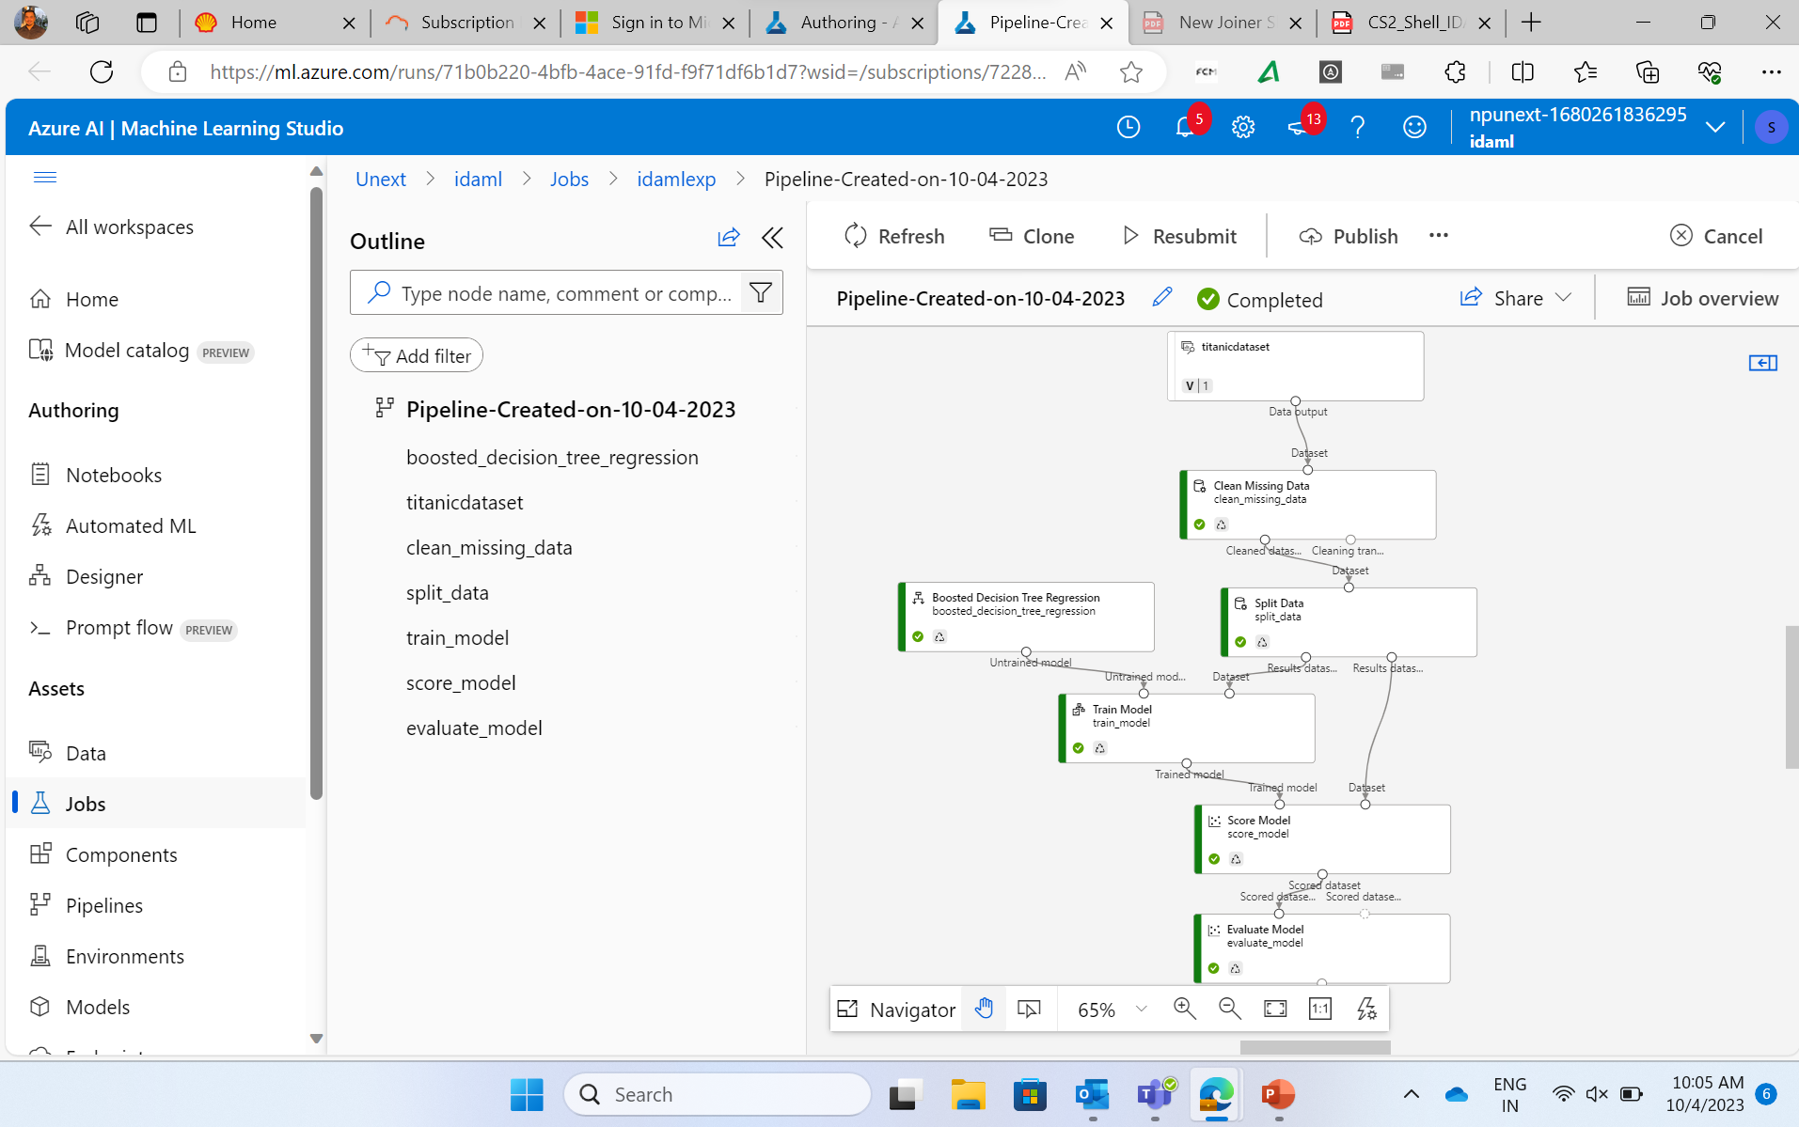

Slide 9
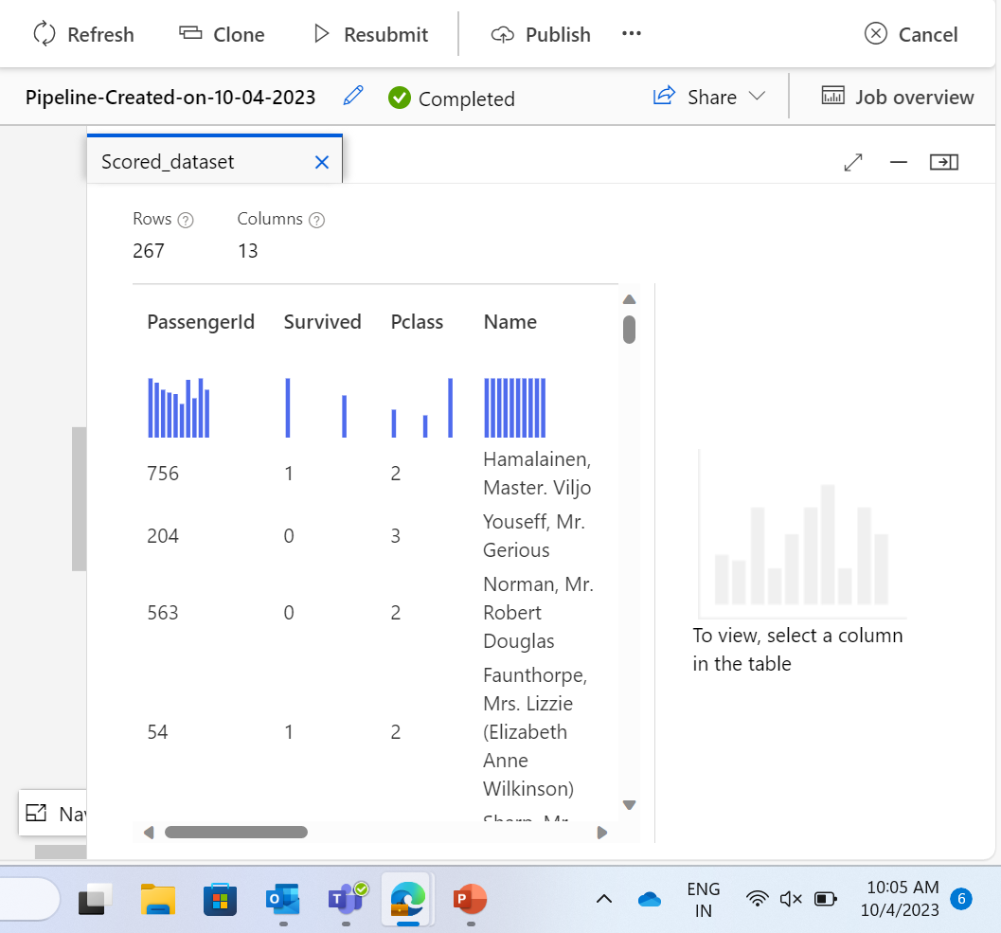
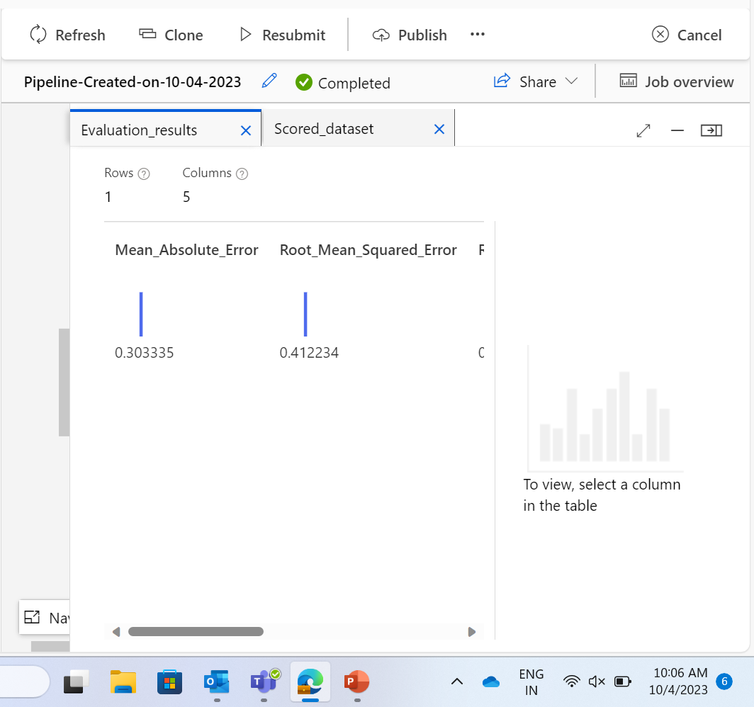

Slide 10
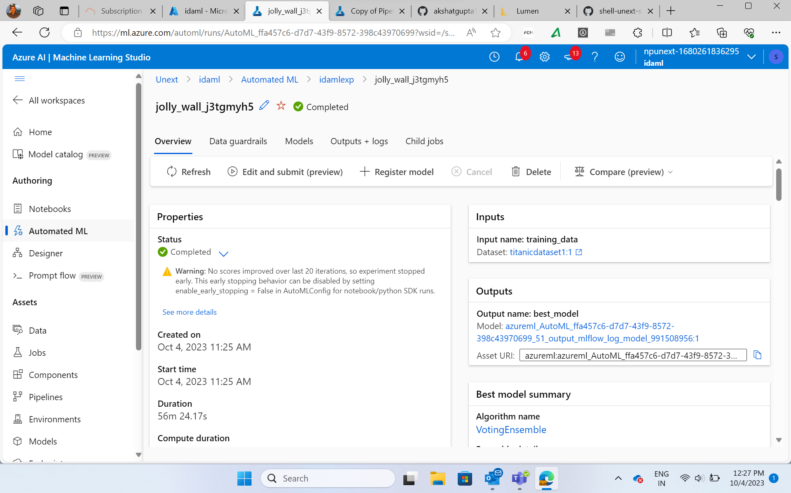

Slide 11
Day 3 & 4
Case Study demonstration and presentation

Slide 12
Thank you
Akshat Gupta
Akshat.gupta2@shell.com

